Slide 1
Chapter 3
Discrete Random Variables
and
Their Probability Distributions

Slide 2
Objectives
Tchebysheff’s Theorem

Slide 3

Tchebysheff’s Theorem
Let X be a random variable with mean $μ$ and finite variance $σ^{2}$. Then, for any constant k > 0 ,
$$P\left(\left|X−μ\right|<kσ\right)≥1−\frac{1}{k^{2}}$$
or
$$P\left(\left|X−μ\right|≥kσ\right)≤\frac{1}{k^{2}}$$

Slide 4
Tchebysheff’s Theorem
The importance of Tchebysheff’s inequality is that it enables us to derive bounds on probabilities when only the mean, or both the mean and the variance, of the probability distribution are known.
Of course, if the actual distribution were known, then the desired probabilities could be exactly computed, and we would not need to resort to bounds.

Slide 5
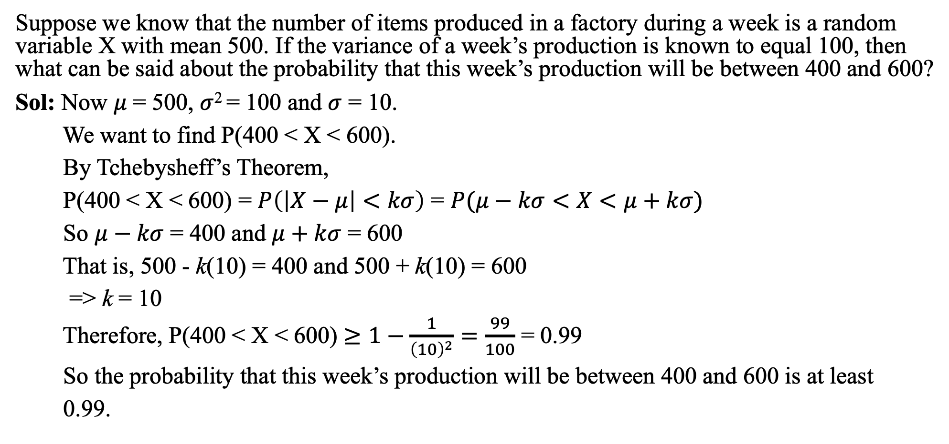
EXAMPLE
Suppose we know that the number of items produced in a factory during a week is a random variable X with mean 500. If the variance of a week’s production is known to equal 100, then what can be said about the probability that this week’s production will be between 400 and 600?
Sol: Now $μ$= 500, $σ$² = 100 and $σ$ = 10.
We want to find P(400 < X < 600).
By Tchebysheff’s Theorem,
P(400 < X < 600) = $P\left(\left|X−μ\right|<kσ\right)$ = $P(μ−kσ<X<μ+kσ)$
So $μ−kσ$ = 400 and $μ+kσ$ = 600
That is, 500 - k(10) = 400 and 500 + k(10) = 600
=> k = 10
Therefore, P(400 < X < 600) $≥1−\frac{1}{{\left(10\right)}^{2}}=\frac{99}{100}$ = 0.99
So the probability that this week’s production will be between 400 and 600 is at least
0.99.

